Slide 1
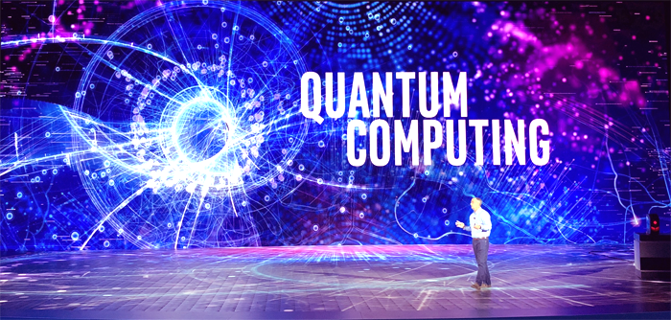
Ronald Wang

Slide 2

Quantum Computing
Ronald Wang
Optum Technology (United Health Group)
Developer, Architect - .Net; Java; Machine Learning
TLCP
Graduate from OSU:
MS: CS, Mechanical Eng., Applied Math
BS: Mechanics and Applied Math
Hobby: Taiji

Slide 3
Quantum Computing
Agenda:
Creating an overall context for understanding (Essence Statement)
History of Scientific Theory of Computation (Binary vs Quantum)
Motivation for pursuing Quantum Computing
Quantum Parallelism
Use Cases
Start of the Art in Quantum Computing
Quantum Computing Theory / Concepts
Architecture
Waves
QuBits
Foundational Ideas
Demo’s (Simulations)
References
Questions

Slide 4
Quantum Computing
What is Quantum Computing?
The essence of Quantum Computing is the creation of a computational system that uses quantum mechanics instead of binary logic to manifest its underlying computational circuitry. Binary theory (Bit) only uses values of ones or zeros in its implementation, whereas Quantum theory (QuBit) uses values of ones, zeros and everything in between.
This fundamental difference appears promising when addressing the following types of difficult problems:
Computationally Hard Problems (for classical computers)
Quantum Parallelism (2^n Operations at the same time)
Quantum Simulators (elementary particle physics)

Slide 5
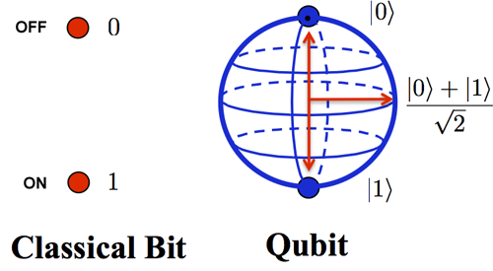
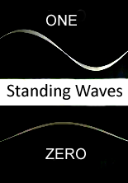
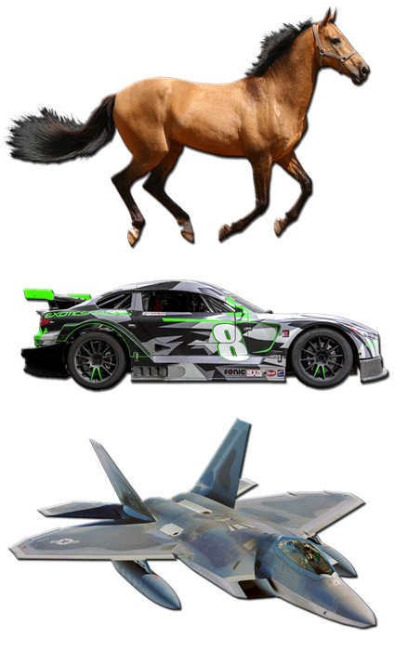
Fundamental Concepts in QC Theory
(Classical: Bits) vs (Quantum : QuBits)
Quantum Computing Theory / Concepts
Binary Notation
Block Sphere Notation
Refresher:
Useful Metaphor
Quantum Computing is powerful…
… not because it does “classical” “things” better or faster, it’s powerful because it does “things” differently.

Slide 6
“Select” Computing History (Binary [240+ yrs] vs Quantum [60+ yrs])
Creating Context: History of Scientific Theory of Computation
Timelines and Innovation Spans
George Boole Publishes Boolean Algebra – Complete system that allowed computational processes to be mathematically modeled.
Atanasoff-Berry – worlds first Digital Computer built Iowa State Campus.
Gottfried Wilhelm Leibniz Develops
Binary Logic
DARPA developing “Molecular Informatics” Program
1854
1939 - 1942
1702
2017
1700
1702
1854
1939 - 1942
2017
2019
Roman Stanisław Ingarden publishes a seminal paper entitled "Quantum Information Theory"
First working
5-qubit NMR TU Munich
7-qubit MNR Los Alamos
University of Copenhagen develops quantum teleportation between photons and atoms.
Richard Feynman conceives of using Quantum Effects for computation.
MIT scientists reported the discovery of a new triple-photon form of light, which may involve polaritons, that could be useful in the development of quantum computers.
Paul Benioff proposes the first recognisable theoretical framework for a quantum computer.
2000
Today
1976
2007
1959
First working 3-qubit
NMR computer
First 12-qubit quantum computer benchmarked.
1982
1998
2006
2018
1950
1959
1976
1982
1998
2000
2006
2007
2018
2019
Binary Computation theory and implementation is mature and robust.
Quantum Computation theory and implementation is not !

Slide 7
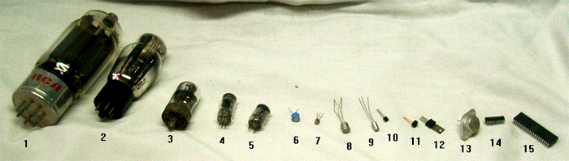
Creating Context:
Physical Manifestation(s) of BINARY circuits and maturity
Binary Computer Circuits
In the first half of the 20th century, analog computers were considered by many to be the future of computing. These devices used the continuously changeable aspects of physical phenomena such as electrical, mechanical, or hydraulic quantities to model the problem being solved, in contrast to digital computers that represented varying quantities symbolically, as their numerical values change. Followed Moore's law.
Today

Slide 8
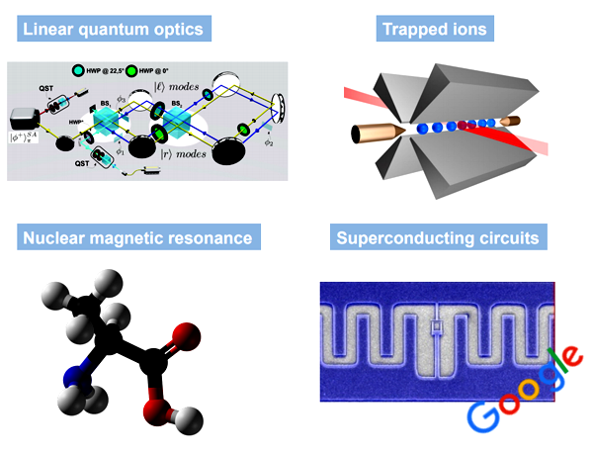
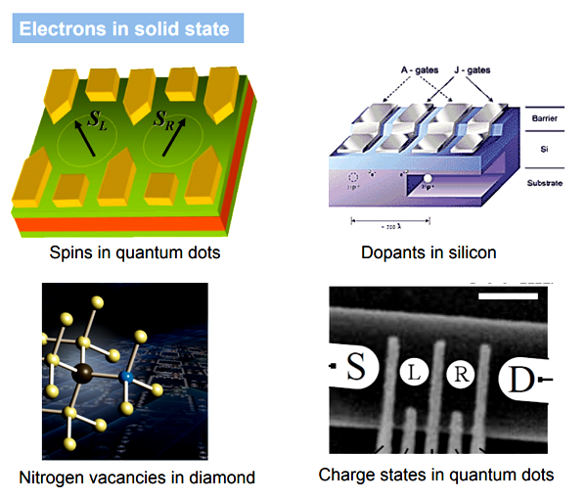
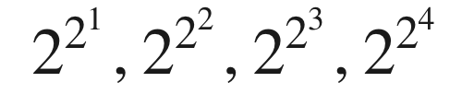
Creating Context:
Physical Manifestation(s) of QUANTUM circuits and maturity
Quantum Computer Circuits
Types of Quantum Processors
Superconducting Circuits
Trapped Ions
Optical Traps
Quantum Dots
Diamond Vacancies
Semiconductor Impurities
Today
Naveen’s law: double exponential growth

Slide 9
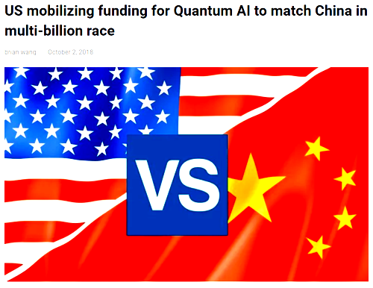
Current Events of Significance ….. Why we should invest in QC
Key Findings
China had announced $10 billion for Quantum research a new facility opening in 2020. Alibaba and other chinese companies will commit over $15 billion for AI and quantum computing research.
US Matching Strategy Focus:
Contribute Billions of $’s.
Choose a “Science First Approach to QIS
Create a Quantum Smart Workforce for Tomorrow.

Slide 10
Creating Context: Maturity of Quantum Mechanics Theory
Key Aspects of intellectual Disagreements persists …..
Quantum Entanglement:
This phenomena was the subject of a 1935 paper by Albert Einstein, Boris Podolsky, and Nathan Rosen, (and several papers by Erwin Schrödinger shortly thereafter), describing what came to be known as the EPR paradox.
Einstein and others considered such behavior to be impossible, as it violated the local realist view of causality (Einstein referring to it as "spooky action at a distance") and argued that the accepted formulation of quantum mechanics must therefore be incomplete.
Later, however, the counter-intuitive predictions of quantum mechanics were verified experimentally in tests where the polarization or spin of entangled particles were measured at separate locations, statistically violating Bell's inequality, demonstrating that the classical conception of "local realism" cannot be correct.
Quantum Wave Function:
Considerable disagreement among scientists still persists.

Slide 11
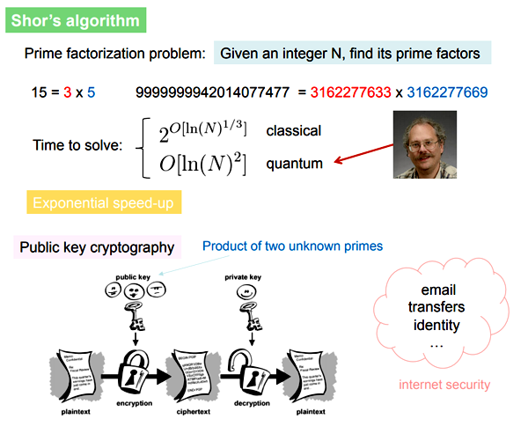
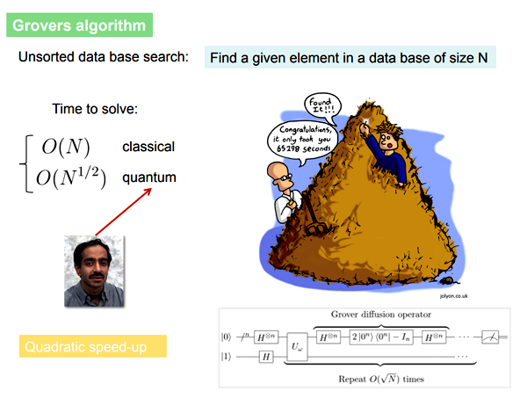
Creating Context: Motivation for pursuing Quantum Computing
Computationally Hard Problems …..
Factorization and Search

Slide 12
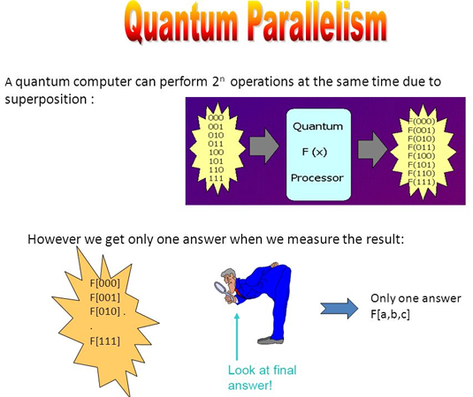
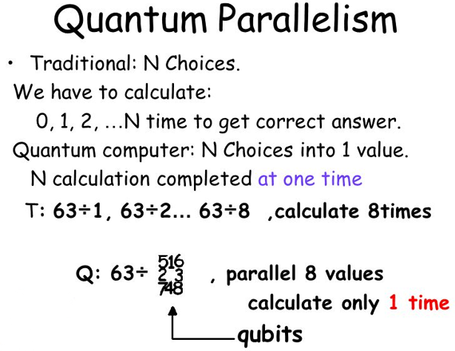
Creating Context: Motivation for pursuing Quantum Computing
Quantum Parallelism…..

Slide 13
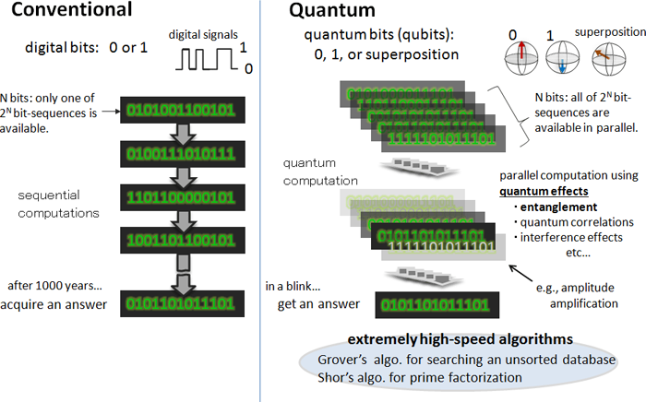
Creating Context: Motivation for pursuing Quantum Computing
Quantum Parallelism…..

Slide 14

Creating Context: Motivation for pursuing Quantum Computing
Quantum Simulators …..
Particle Physics Simulator:
Quantum Computers can simulate many-particle systems much faster than any classical computer.
Particle Physics
Chemical
Materials Science
Optimization
Genetic
Artificial Intelligence / Machine Learning
Molecular Modeling
Cryptography
Financial Modeling
Weather Forecasting

Slide 15
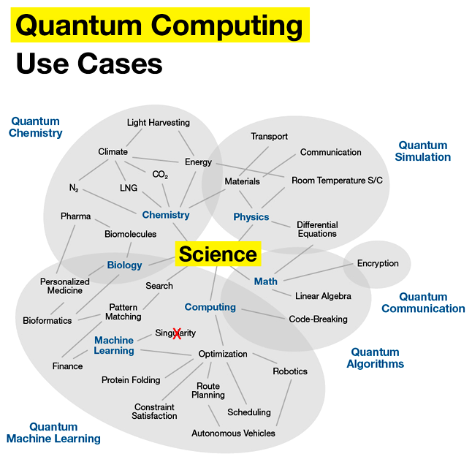
Creating Context: Motivation for pursuing Quantum Computing

Slide 16
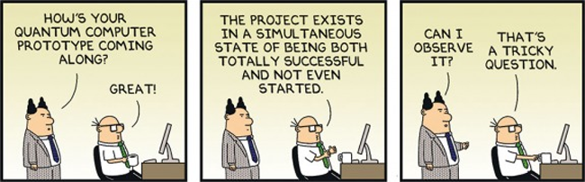
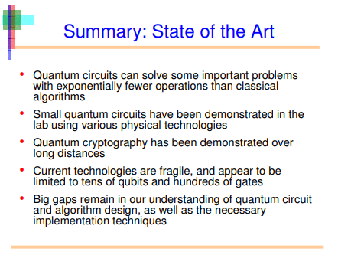
Creating Context: State of the Art…..
The promise of quantum computation is real, but the technological hurdles are huge. There seems to be no clear or obvious champion in the race to achieve fault tolerant quantum computation.

Slide 17
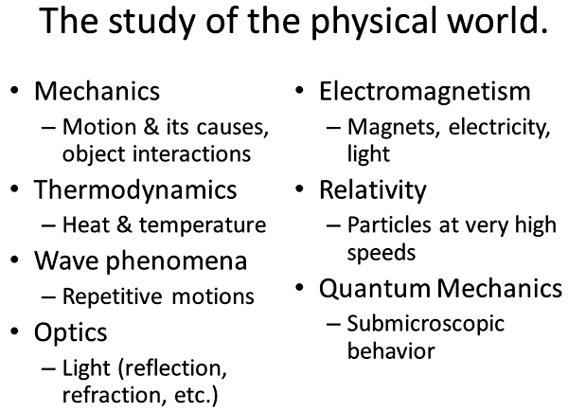
Quantum Computing Theory / Concepts
Physics

Slide 18
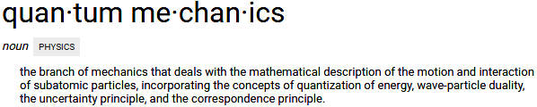
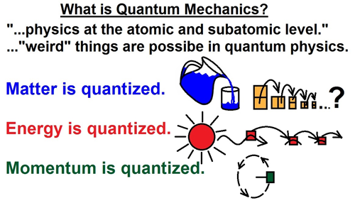
Quantum Computing Theory / Concepts
Physics – Quantum Mechanics
Quantum is the Latin word for amount and, in modern understanding, means the smallest possible discrete unit of any physical property, such as energy or matter. Quantum came into the latter usage in 1900, when the physicist Max Planck used it in a presentation to the German Physical Society.
Everything Is Made Of Waves; Also, Particles
Quantum Physics Is Discrete
Quantum Physics Is Probabilistic
Quantum Physics Is Non-Local
Quantum Physics Is (Mostly) Very Small
Quantum Physics Is Not Magic

Slide 19
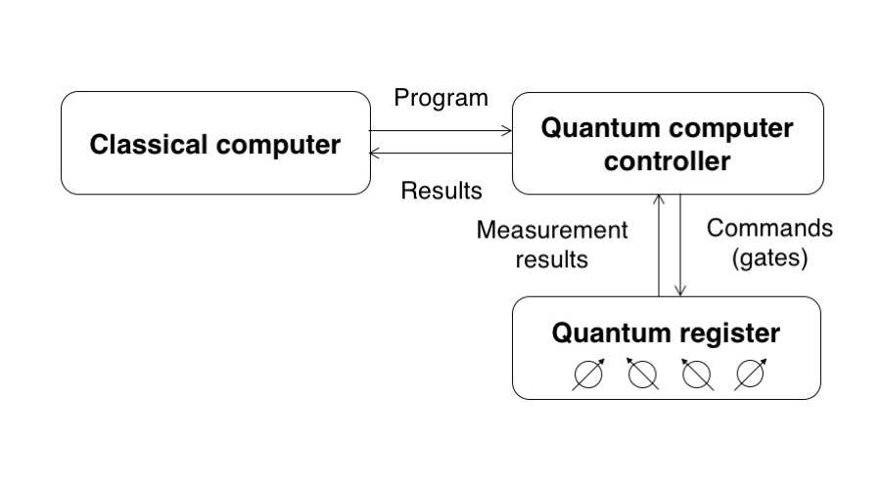
Quantum Computing Theory / Concepts
Architecture
(Think Co-Processor, not entire computer)
A quantum computer has both classical and quantum parts. The program is (at least for the moment) entirely classical, stored in a classical controller. A quantum algorithm uses both classical and quantum data.
One way to look at the overall system is to treat the quantum part as a co-processor to a classical system. Like the GPU (graphics processing unit) in your desktop or laptop computer, a quantum computer is used to perform specific tasks in the context of a larger program.
Not Big Data, Nor Super Computing :- Quantum computers do I/O very poorly and can't handle much data - so big data is out of the question.

Slide 20
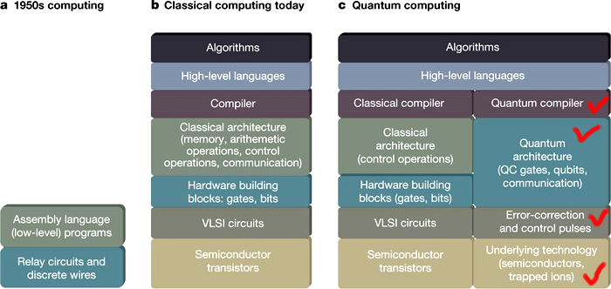
Quantum Computing Theory / Concepts
Architecture(s) - Comparison

Slide 21
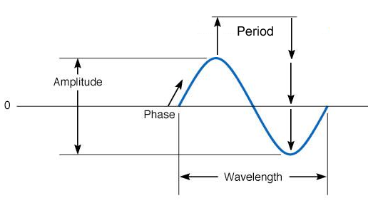
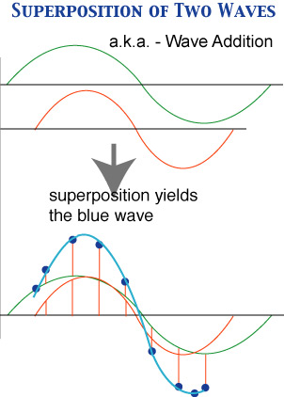
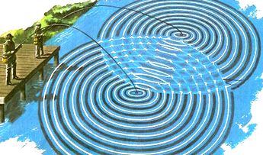
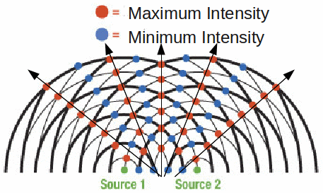
Fundamental Concepts in QC Theory
Standing Waves
Period, Amplitude, Phase, Wavelength
Superposition
Interference
Quantum Computing Theory / Concepts
Waves (Big Problem:- Containment”)
Wave Interference

Slide 22
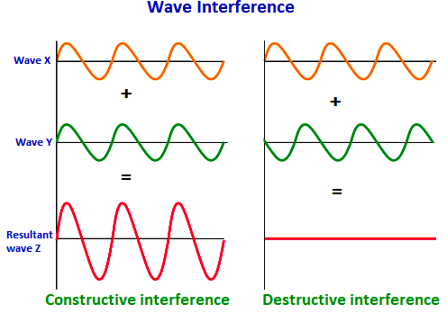
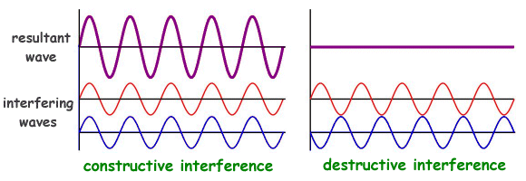
Fundamental Concepts in QC Theory
Standing Waves
Period, Amplitude, Phase, Wavelength
Superposition
Interference
Quantum Computing Theory / Concepts
Waves
Superposition
One of the most important concepts you must grasp to understand quantum computing is the superposition and interference of waves. Since waves are moving through space, you can have more than one wave passing through one place at the same time. When that happens, the wave add up, or superimpose on one another.
Interference
When more than one wave pass through the same space at the same time.
1, 2 and N dimensional Interferences.

Slide 23
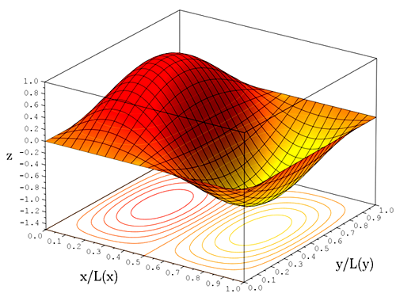

Fundamental Concepts in QC Theory
Wave Function
Quantum Computing Theory / Concepts
Waves
Schrodinger’s Equation
Generates (describes) the wave function.
(Still disagreement among researchers and theorists)
Schrodinger’s Cat = Superposition

Slide 24
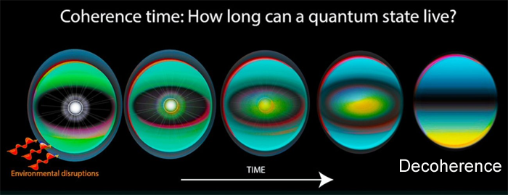
Fundamental Concepts in QC Theory
Wave Coherence
Quantum Computing Theory / Concepts
Waves
In physics, two wave sources are perfectly coherent if they have a constant phase difference and the same frequency, and the same waveform. Coherence is an ideal property of waves that enables stationary (i.e. temporally and spatially constant) interference. In quantum mechanics, particles such as electrons are described by a wave function, a mathematical description of the quantum state of a system; the probabilistic nature of the wavefunction gives rise to various quantum effects. As long as there exists a definite phase relation between different states, the system is said to be coherent.

Slide 25
Fundamental Concepts in QC Theory
Wave DeCoherence
Quantum Computing Theory / Concepts
Waves
This coherence is a fundamental property of quantum mechanics, and is necessary for the function of quantum computers. However, when a quantum system is not perfectly isolated, but in contact with its surroundings, the coherence decays with time, a process called quantum decoherence - collapse of the wavefunction.

Slide 26
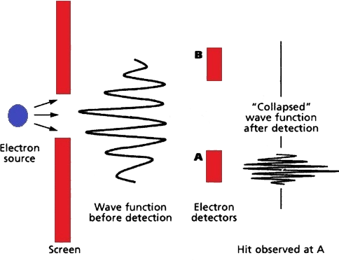
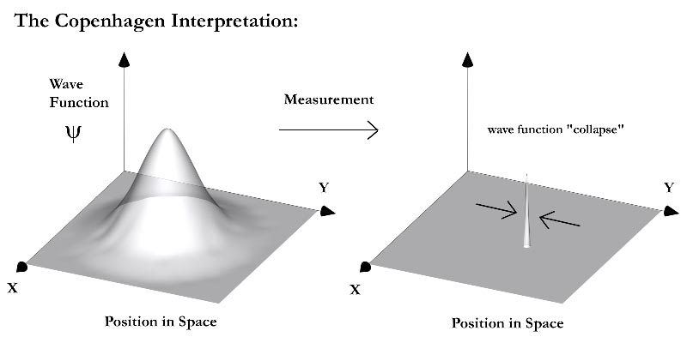
Fundamental Concepts in QC Theory
Wave Function Collapse
Quantum Computing Theory / Concepts
Waves
This coherence is a fundamental property of quantum mechanics, and is necessary for the function of quantum computers. However, when a quantum system is not perfectly isolated, but in contact with its surroundings, the coherence decays with time, a process called quantum decoherence - collapse of the wavefunction.

Slide 27
Back to Quantum Humor ……

Slide 28
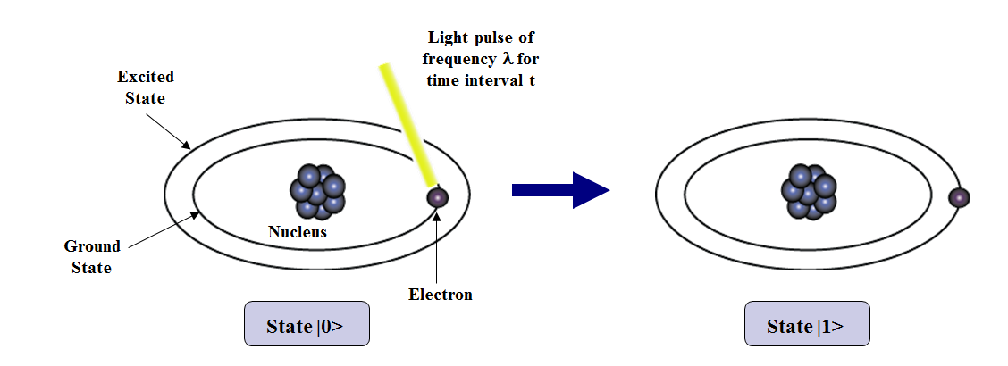
Fundamental Concepts in QC Theory
(Classical) vs Bits (Quantum)
Quantum Computing Theory / Concepts
QuBits
Qubit is a bit of data represented by a single atom that is in one of two states denoted by |0> and |1>.
It is the basic unit of information in a quantum computer.
A physical implementation of a qubit could use the two energy levels of an electron in the atom. An excited state representing |1> and a ground state representing |0>.

Slide 29
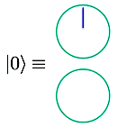
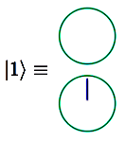
Fundamental Concepts in QC Theory
(Classical) vs Bits (Quantum)
Quantum Computing Theory / Concepts
QuBits
Binary Notation
Block Sphere Notation
KET Notation (Value & Phase)
Refresher:
QuBits (Standing Waves) Have “Phases” – Like the Moon.
QuBits model properties of waves
Like binary notation, but with in-between values
Represented by Block Sphere notation
Represented by KET Notation (ABS Value)
They have Phases
QuBits have two Characteristics: their Value and their Phase.

Slide 30
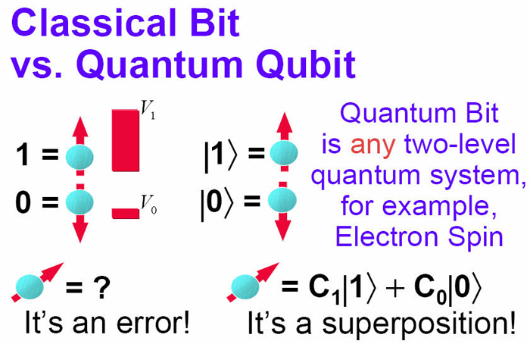
Fundamental Concepts in QC Theory
(Classical) vs Bits (Quantum)
Quantum Computing Theory / Concepts
QuBits
Refresher:
Waves add up, or superimpose on one another.
North pole = 1
South Pole = 0
Other Locations are Superposition.

Slide 31
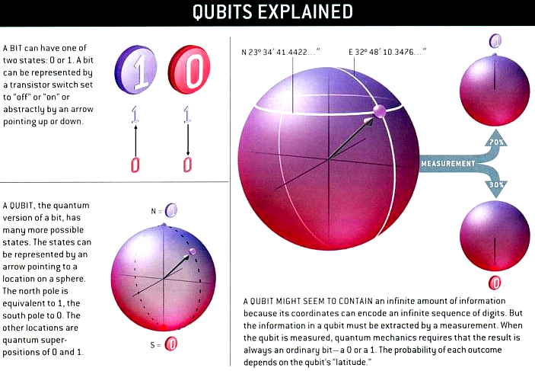
Fundamental Concepts in QC Theory
(Classical) vs Bits (Quantum)
Quantum Computing Theory / Concepts
QuBits
Refresher:

Slide 32
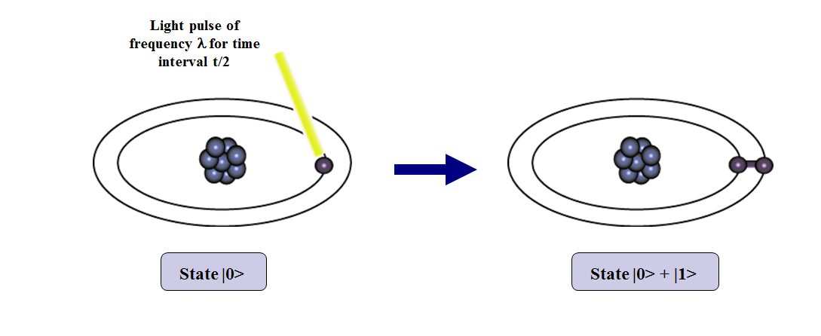
Qubits Explained
A single qubit can be forced into a superposition of the two states denoted by the addition of the state vectors:
|ψ> = α₁ |0> + α₂ |1>,
where α₁ and α₂ are complex numbers and |α₁|² + |α₂|² = 1,
|α₁|² represents the probability of the superposition collapsing to |0>.
There are 2^{n} possible states per qubit, where n is the no. of qubits.

Slide 33
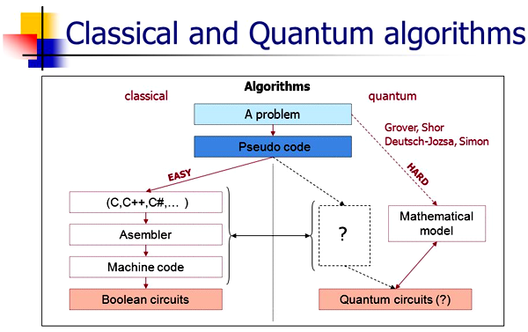
Quantum Computing Theory / Concepts
Quantum Algorithms
The term quantum algorithm is usually used for those algorithms which seem inherently quantum, or use some essential feature of quantum computation such as quantum superposition or quantum entanglement.
The most well known algorithms are Shor's algorithm for factoring, and Grover's algorithm for searching an unstructured database or an unordered list. Shor's algorithms runs exponentially faster than the best known classical algorithm for factoring, Grover's algorithm runs quadratically faster than the best possible classical algorithm for the same task.

Slide 34
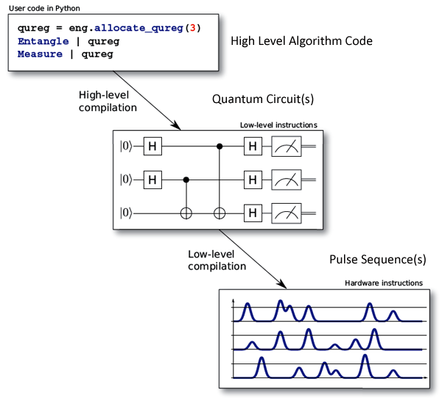
Quantum Computing Theory / Concepts
Quantum Algorithm(s)

Slide 35
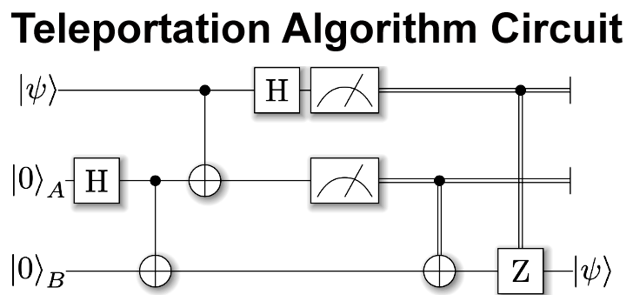
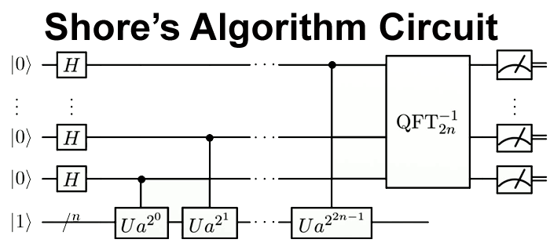
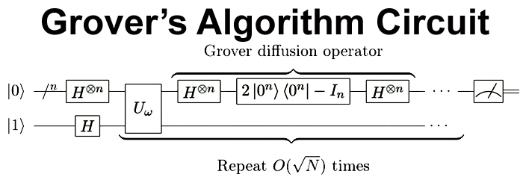
Quantum Computing Theory / Concepts
Foundational Ideas – Quantum Circuit Diagram(s)

Slide 36
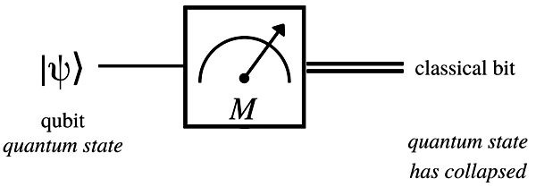
Quantum Computing Theory / Concepts
Foundational Ideas – Quantum Measurement
The measurement problem in quantum mechanics is the problem of how (or whether) wave function collapse occurs. The inability to observe this process directly has given rise to different interpretations of quantum mechanics, and poses a key set of questions that each interpretation must answer.
Measure – Single, Multi, Partial Measurement of QuBit System.

Slide 37
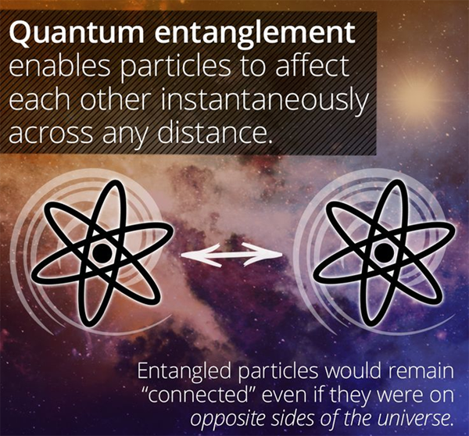
Bell Pairs (or Bell States)
The most basic form of entangled state.
Quantum Computing Theory / Concepts
Foundational Ideas – Quantum Entanglement
Spooky Action at a Distance
Einstein and others considered such behavior to be impossible, as it violated the local realist view of causality (Einstein referring to it as "spooky action at a distance") and argued that the accepted formulation of quantum mechanics must therefore be incomplete.
Later, however, the counter-intuitive predictions of quantum mechanics were verified experimentally in tests where the polarization or spin of entangled particles were measured at separate locations, statistically violating Bell's inequality, demonstrating that the classical conception of "local realism" cannot be correct.
NOTE: Just because “local realism” isn’t correct, Quantum Mechanics
isn’t proven to be “complete”.

Slide 38
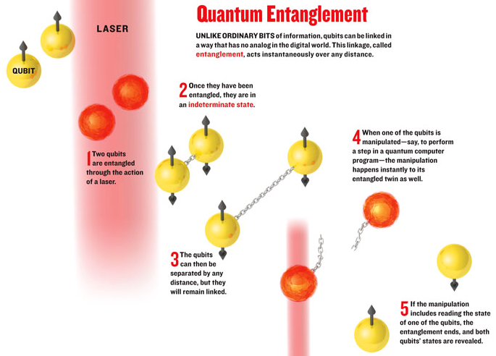

Slide 39
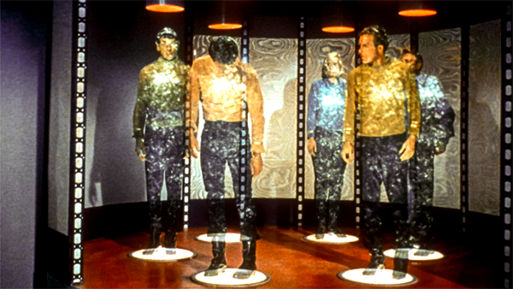
Quantum Computing Theory / Concepts
Foundational Ideas – Quantum Teleportation
One of the most important uses of entanglement is quantum teleportation. In teleportation, the state of one qubit is destroyed in one place and resurrected in another, accomplished by using entanglement. Teleportation is a fundamental primitive in quantum networking, and in executing certain types of quantum computing.
This is a phenomenon whereby the quantum information of one atom or photon can be transmitted to another atom or photon without any physical thing traveling between the two.

Slide 40
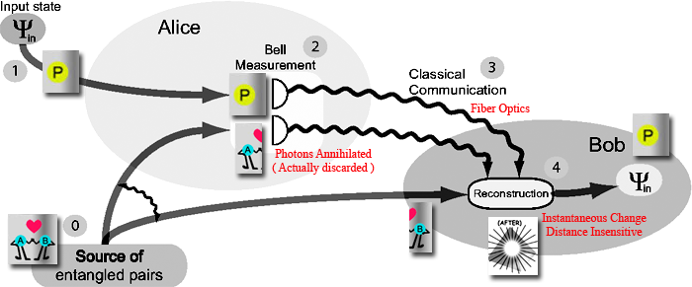
Quantum Computing Theory / Concepts
Foundational Ideas – Quantum Teleportation

Slide 41
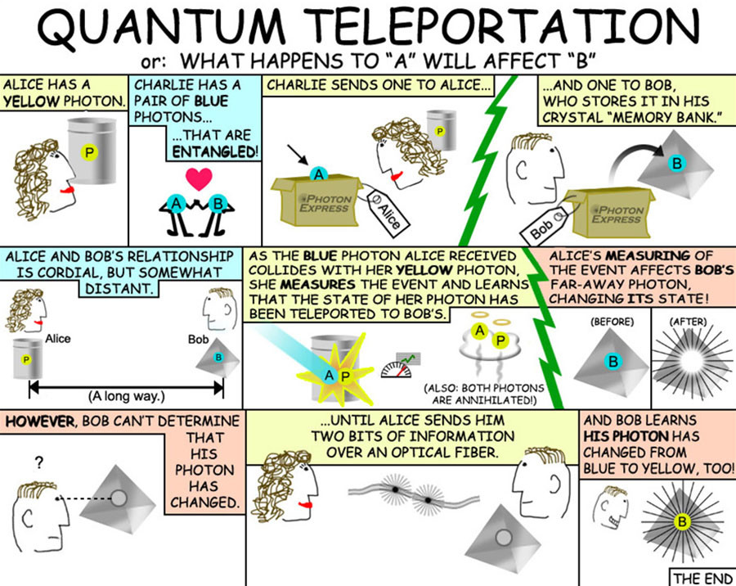

Slide 42
Quantum Computing Theory / Concepts
Foundational Ideas – Quantum Supremacy
The term quantum supremacy has been used to describe demonstration of a quantum computer that can solve problems that a classical computer can not.
It is worth asking the question in the opposite direction: simulating the behavior of a quantum computer using a classical computer is hard. What’s the largest quantum computer we can simulate? We have talked about the exponential growth in the size of our state vector with the number of Qubits. This can serve as a rough guide to what is possible:
Bits/Qubits | Classic Storage (bytes) | Quantum Storage (bits) | Quantum Storage (bytes) | reading
4 | 1 | 2^4 = 16 | 2
8 | 1 | 2^8 = 256 | 32
32 | 4 | 2^32 = 4.2 E+9 | 5.30E+08 | Giga Bytes
50 | 6 | 2^50 |  | Peta Bytes
64 | 8 | 2^64 = 1.8 E+19 | 2.3E +18
From this kind of table, and experience with large-scale quantum simulations, researchers reasoned that classical computers would struggle to simulate quantum computers larger than fifty qubits. Therefore, a quantum computer of fifty qubits or more should be able to do things that a classical computer can’t.

Slide 43
Demo: Grover Search Algorithm

Slide 44
Quantum Computing References
Future Learn - Understanding Quantum Computers
https://www.futurelearn.com/courses/intro-to-quantum-computing
Einstein's "Spooky Action at a Distance" Paradox Older Than Thought
https://www.technologyreview.com/s/427174/einsteins-spooky-action-at-a-distance-paradox-older-than-thought/
The Universe Is as Spooky as Einstein Thought
https://www.theatlantic.com/science/archive/2017/02/spooky-action-at-a-distance/516201/
NIST team proves 'spooky action at a distance' is really real
https://phys.org/news/2015-11-nist-team-spooky-action-distance.html
Quantum Entanglement (WIKI)
https://en.wikipedia.org/wiki/Quantum_entanglement
Difficulties in the Implementation of Quantum Computers
https://arxiv.org/ftp/cs/papers/0602/0602096.pdf
The trouble with quantum computing
https://eandt.theiet.org/content/articles/2016/11/the-trouble-with-quantum-computing/
Quantum Computing Use Cases
https://blogs.gartner.com/smarterwithgartner/files/2017/11/PR_338248_CIOsGuideToQuantumComputing_Graphics.jpg
6 Things Quantum Computers Will Be Incredibly Useful For
https://singularityhub.com/2017/06/25/6-things-quantum-computers-will-be-incredibly-useful-for/#sm.0000sqx3e3vagczbz2w2ihnmf761e
Tutorial: Basic Concepts in Quantum Circuits
http://vlsicad.eecs.umich.edu/BK/Slots/cache/www.eecs.umich.edu/~jhayes/JPH_DACslides_Jun03.pdf

Slide 45
Quantum Computing References
Does the Quantum Computer Exist Today
https://www.quora.com/Does-the-quantum-computer-exist-today
Schrodingers Equation
https://www.khanacademy.org/science/physics/quantum-physics/atoms-and-electrons/v/quantum-wavefunction?utm_campaignID=1338362387&utm_campaignname=&utm_keyword=&utm_device=c&gclid=Cj0KCQjw0a7YBRDnARIsAJgsF3Ou3Us1_ounuEaJtDb1y4-wlYH1t5CpLJAsl256II9DQLKpxNP3juIaAqRzEALw_wcB
Quantum Decoherence
https://scottamyx.com/2017/08/24/quantum-computing-part-8-decoherence/
The Future of Computing – Quantum & Qubits
https://www.autodesk.com/products/eagle/blog/future-computing-quantum-qubits/
Wave Function Collapse
http://www.mysearch.org.uk/website1/html/549.Collapse.html
Chinese and Canadian Scientists a Step Closer to Secure Quantum Internet
https://hacked.com/chinese-canadian-scientists-step-closer-secure-quantum-internet/
Intel Teaches Quantum Computing 101
https://www.nextplatform.com/2018/05/03/intel-teaches-quantum-computing-101/
Getting started with Q# programming:
https://www.c-sharpcorner.com/article/getting-started-with-q-programming/
Microsoft Quantum Development Kit: Introduction and step-by-step demo https://www.youtube.com/watch?v=v7b4J2INq9c

Slide 46
Quantum Computing References
Q# Is for Quantum Computing: A New Programming Language from Microsoft https://www.allaboutcircuits.com/news/q-is-for-quantum-computing-programming-language-Microsoft/
How to program a quantum computer https://medium.com/qiskitters/how-to-program-a-quantum-computer-982a9329ed02
Q# , a quantum computation package for the .NET platform
https://arxiv.org/ftp/arxiv/papers/1302/1302.5133.pdf
Microsoft Q# Quantum Language And Toolkit
http://www.i-programmer.info/news/105-artificial-intelligence/11383-microsoft-q-quantum-language-and-toolkit.html
MS Q#:
https://freestartupkits.com/articles/technology/tech-tips-and-tricks/how-to-write-in-q-microsofts-quantum-computing-code/
MS Q# Vaporware:
https://www.forbes.com/sites/fredcampbell/2017/12/18/microsofts-quantum-computing-vaporware/#3473bb9c2b24
Q# Language:
https://docs.microsoft.com/en-us/quantum/quantum-qr-intro?view=qsharp-preview
Quantum Chemistry
http://www.msg.ameslab.gov/tutorials/quantumintro.pdf
What is Quantum Chemistry?
https://study.com/academy/lesson/what-is-quantum-chemistry.html
Ideas of Quantum Chemistry
https://www.sciencedirect.com/science/book/9780444522276

Slide 47
Quantum Computing References
Link to a blog where Scott Aronson reviews an article on quantum computing: https://www.scottaaronson.com/blog/?m=201802
List of QC simulators: https://www.quantiki.org/wiki/list-qc-simulators
Long, but easy to comprehend lectures on quantum concepts: https://www.youtube.com/watch?v=pBh7Xqbh5JQ
AN INTRODUCTION TO QUANTUM COMPUTING
https://arxiv.org/pdf/0708.0261.pdf
A Gentle Introduction to Quantum Computing
http://physlab.org/wp-content/uploads/2016/03/Abdullah-Khalid.pdf
An Introduction to Quantum Computing for Non-Physicists
https://arxiv.org/pdf/quant-ph/9809016.pdf
An Introduction to Quantum Algorithms
https://people.cs.umass.edu/~strubell/doc/quantum_tutorial.pdf
QUANTUM COMPUTING: AN INTRODUCTION
https://pdfs.semanticscholar.org/3d1f/7de876b57952fded28adfbb74d5cd4249b02.pdf
Introduction to Quantum Computing
https://blogs.msdn.microsoft.com/uk_faculty_connection/2018/02/06/introduction-to-quantum-computing/
An Introduction To Quantum Computing - Microsoft
https://code.msdn.microsoft.com/An-Introduction-To-Quantum-62671688
A Beginner’s Guide to Quantum Computing and Q#
https://blogs.msdn.microsoft.com/uk_faculty_connection/2018/02/06/a-beginners-guide-to-quantum-computing-and-q/

Slide 48
Quantum Computing References
Microsoft Q# Programming Introduction For Quantum Computing
https://artofengineer.com/articles/programming/microsoft-q-sharp-programming-introduction-for-quantum-computing/
Q# – Introduction to quantum computing
https://dajbych.net/q-introduction-to-quantum-computing
Quantum Physics for Dummies:
http://ffmgu.ru/images/2/24/Holzner_Steve_-_Quantum_Physics_For_Dummies.pdf
A Startup Uses Quantum Computing to Boost Machine Learning
https://www.technologyreview.com/s/609804/a-startup-uses-quantum-computing-to-boost-machine-learning/
How Quantum Computers Will Revolutionize Artificial Intelligence, Machine Learning And Big Data
https://www.forbes.com/sites/bernardmarr/2017/09/05/how-quantum-computers-will-revolutionize-artificial-intelligence-machine-learning-and-big-data/#240ceeba5609
Google Quantum A.I.
https://research.google.com/pubs/QuantumAI.html
Quantum computers may be more of an imminent threat than AI
https://www.washingtonpost.com/news/innovations/wp/2018/02/05/quantum-computers-may-be-more-of-an-imminent-threat-than-ai/?noredirect=on&utm_term=.8f6d64db298a
Job One for Quantum Computers: Boost Artificial Intelligence
https://www.quantamagazine.org/job-one-for-quantum-computers-boost-artificial-intelligence-20180129/
The Argument Against Quantum Computers
https://www.quantamagazine.org/gil-kalais-argument-against-quantum-computers-20180207/

Slide 49
Quantum Computing References
Quantum Artificial Intelligence Lab
https://en.wikipedia.org/wiki/Quantum_Artificial_Intelligence_Lab
History of Computers
http://slideplayer.com/slide/6495021/
What are Quantum Computers
https://disruptionhub.com/wp-content/uploads/2016/02/PUB_CQC_Cambridge_Quantum_Computing_Explained_lg.png
History of Quantum Computing
https://people.maths.bris.ac.uk/~csxam/teaching/history.pdf
Binary:
https://en.wikipedia.org/wiki/History_of_computer_science
https://www.livescience.com/20718-computer-history.html
Quantum:
https://en.wikipedia.org/wiki/Timeline_of_quantum_computing
QC for Dummies:
http://www.ftf.lth.se/fileadmin/ftf/Course_pages/FAFA55/2015/foerelaesning/15_Ga__stlektion_Kvantinformation.pdf
QC for beginners:
https://physicsandcake.files.wordpress.com/2010/02/qc_for_beginners.pdf
New Material found for Quantum Computing - copper phthalocyanine (CuPc)
https://www.london-nano.com/research-and-facilities/highlight/new-material-for-quantum-computing-discovered-out-of-the-blue
https://news.stanford.edu/2017/05/09/new-materials-bring-quantum-computing-closer-reality/

Slide 50
Quantum Computing References
Need, promise and Reality of QC:
https://towardsdatascience.com/the-need-promise-and-reality-of-quantum-computing-4264ce15c6c0
QC Explained: (Online Book) => Excellent book for explaining nuances of Quantum Mechanics
https://www.clerro.com/guide/580/quantum-computing-explained
QC Architecture:
https://www.nii.ac.jp/qis/first-quantum/symposium/2011/pdf/van02_summerSchool2011.pdf
https://homes.cs.washington.edu/~oskin/Oskin-A-Practical-Architecture-for-Reliable-Quantum-Computers.pdf
https://www.microsoft.com/en-us/research/wp-content/uploads/2016/02/10Svore-Cross-Aho-Chuang-Markov.pdf
QC Error correction
https://theconversation.com/error-correcting-the-things-that-go-wrong-at-the-quantum-computing-scale-84846
https://www.doc.ic.ac.uk/~ig415/ErrorCorrection.html
http://news.mit.edu/2015/quantum-error-correction-0526
3 Types of Quantum Computers and their Applications
http://www.visualcapitalist.com/three-types-quantum-computers/
QC Slide Share
https://www.slideshare.net/MirandaGhrist/quantum-computers-quantum-key-distribution-quantum-networks-61635700
HW Paper from MIT (excellent paper)
http://qeg.mit.edu/images/QuantumComputing.pdf
D:Wave
https://www.dwavesys.com/tutorials/background-reading-series/quantum-computing-primer

Slide 51
Quantum Computing References
NYU - QC Tutorial
https://www-users.cs.york.ac.uk/schmuel/comp/comp.html
IBM - Intro to Quantum Computing
https://www.ibm.com/developerworks/library/l-quant/index.html
Programming Battleship using QC
https://medium.com/qiskitters/how-to-program-a-quantum-computer-982a9329ed02
GitHub: Jupyter NB : - https://github.com/quantumjim/qiskit-tutorial/blob/master/reference/games/battleships_with_partial_NOT_gates.ipynb
Latest Vintage: - https://github.com/QISKit/qiskit-tutorial
Install Guide: - https://github.com/QISKit/qiskit-tutorial/blob/master/INSTALL.md
Write a Quantum Program: - Microsoft Docs (Q#)
https://docs.microsoft.com/en-us/quantum/quantum-writeaquantumprogram?view=qsharp-preview&tabs=tabid-vs2017
Beginners Guide: - MS Faculty Connection
https://blogs.msdn.microsoft.com/uk_faculty_connection/2018/02/06/a-beginners-guide-to-quantum-computing-and-q/
QC Playground
http://www.quantumplayground.net/#/home
QC Tutorial:
http://helper.ipam.ucla.edu/publications/nanotut/nanotut_1865.pdf
Quantum Wierdness in your browser
https://hackaday.com/2018/01/24/quantum-weirdness-in-your-browser/

Slide 52
Quantum Computing References
Quantum ToolBox in Python:
http://qutip.org/tutorials.html
* http://nbviewer.jupyter.org/github/qutip/qutip-notebooks/tree/master/development/
Quantum Computing Explained:
https://hackernoon.com/quantum-computing-explained-a114999299ca
Amazon:
https://www.amazon.com/s/?ie=UTF8&keywords=quantum+computation+information&tag=googhydr-20&index=stripbooks&hvadid=241631576157&hvpos=1o2&hvnetw=g&hvrand=11535703295688676539&hvpone=&hvptwo=&hvqmt=b&hvdev=c&hvdvcmdl=&hvlocint=&hvlocphy=9019698&hvtargid=kwd-363208936699&ref=pd_sl_71qexwnay6_b_p37
D:Wave
DWave HW: - https://www.dwavesys.com/tutorials/background-reading-series/introduction-d-wave-quantum-hardware
THE REVOLUTIONARY QUANTUM COMPUTER THAT MAY NOT BE QUANTUM AT ALL
https://www.wired.com/2014/05/quantum-computing/
But to really be called a quantum computer, you also have to be, as Aaronson puts it, “productively quantum.
Hype?
https://www.csail.mit.edu/news/does-googles-quantum-computer-live-hype
From Fantasy to Reality - QC coming to the marketplace
https://www2.deloitte.com/insights/us/en/focus/signals-for-strategists/quantum-computing-enterprise-applications.html?id=us:2ps:3gl:lookagainfy18:eng:greendot:111617:nonem:na:zX4NySth:1079921058:270789361564:b:RLSA_Innovation:RLSA_Quantum_Computing_BMM:nb
Los Alamos Labs QC Article:
http://www.lanl.gov/discover/publications/1663/2016-july/_assets/docs/1663_JULY-2016-Not-Magic-Quantum.pdf

Slide 53
Quantum Computing References
Hype Articles:
Massive disruption coming with QC (Singularity Hub) - When quantum computing pans out, we’ll be able to control the very building blocks of the universe.
https://singularityhub.com/2016/10/10/massive-disruption-quantum-computing/#sm.0000sqx3e3vagczbz2w2ihnmf761e
The Rise of Quantum Computers And The Ensuing Disruption
https://www.non-newz.com/the-rise-of-quantum-computers-and-the-ensuing-disruption/
Serious quantum computers are finally here. What are we going to do with them?
https://www.technologyreview.com/s/610250/hello-quantum-world/
Quantum computers ready to leap out of the lab in 2017
https://www.nature.com/news/quantum-computers-ready-to-leap-out-of-the-lab-in-2017-1.21239
CIOs need to understand the disruptive power of quantum computing and potential applications in AI, machine learning, and data science.
https://www.gartner.com/smarterwithgartner/the-cios-guide-to-quantum-computing/
This Is Why Quantum Computing Is More Dangerous Than You Realize
https://www.forbes.com/sites/jasonbloomberg/2017/08/11/this-is-why-quantum-computing-is-more-dangerous-than-you-realize/#6a591443babb
World’s Leading Physicist Says Quantum Computers Are “Tools of Destruction, Not Creation”
https://futurism.com/worlds-leading-physicist-says-quantum-computers-are-tools-of-destruction-not-creation/
QUANTUM COMPUTING IS GOING COMMERCIAL WITH THE POTENTIAL TO DISRUPT EVERYTHING
http://www.newsweek.com/2017/04/21/quantum-computing-ibm-580751.html

Slide 54
Quantum Computing References
WHAT IF QUANTUM COMPUTERS USED HARD DRIVES MADE OF DNA?
https://www.wired.com/2017/03/quantum-computers-used-hard-drives-made-dna/
Quantum Computers Compete for "Supremacy"
Two technologies may be on the verge of surpassing even the most powerful digital computers in a year or so, but key challenges remain unsolved
https://www.scientificamerican.com/article/quantum-computers-compete-for-supremacy/
The Golden Age Of Quantum Computing Is Upon Us (Once We Solve These Tiny Problems)
https://www.fastcompany.com/3045708/big-tiny-problems-for-quantum-computing
Quantum Computing Is Going to Change the World. Here’s What This Means for You.
https://futurism.com/quantum-computing-qa/
Quantum Computers Bust Problem Conventional Computers Can't Solve
https://www.livescience.com/61054-quantum-computer-50-qubits.html
The quantum computing apocalypse is imminent
https://techcrunch.com/2018/01/05/the-quantum-computing-apocalypse-is-imminent/
How quantum computing will change the world
https://www.newstatesman.com/science-tech/technology/2017/12/how-quantum-computing-will-change-world

Slide 55
Quantum Computing References
Reality Articles:
Despite increased interest, quantum computing is still years away
https://www.information-management.com/news/quantum-computing-is-coming-quantum-computing-is-coming
Hype and cash are muddying public understanding of quantum computing
https://phys.org/news/2017-08-hype-cash-muddying-quantum.html
Not even IBM is sure where its quantum computer experiments will lead
https://www.engadget.com/2018/02/23/ibm-q-quantum-computer-experiments/
How good are today’s quantum computers really?
https://medium.com/@decodoku/how-good-are-todays-quantum-c
The Commercial Prospects for Quantum Computing
http://qutip.org/news/Commercial_Prospects_for_Quantum_Computing_Dec_2016.pdf
Project Q: An open source software framework for quantum computing
https://quantum-journal.org/papers/q-2018-01-31-49/pdf/
Quantum Computing : - State of Play
http://oc.acm.org/docs/qc-state-of-play.pdf

Slide 56
Questions?

Slide 57
8/28: Chris Bartlett Professor at Nationwide Children Hospital Extending a distance base classifier​ implemented as a single qubit perceptron
What is Next?

Slide 58

Open Positions in Columbus, OH
1
Senior .NET Developer
5
Senior Front End Developer
– Angular, React, Node js
2
React Developer
6
Drupal Developer
3
Senior DevOps Consultant
7
Ruby on Rails Developer
4
Senior QA/Test Engineer
Resumes to careers@improving.com
*Reference Columbus

Slide 59
Upcoming Training in Houston
August 5-6 Professional Scrum Master
September 11-12 Professional Scrum Product Owner
September 23-24 Professional Scrum Master
November 4-5 Professional Scrum Master
*** Training Discount Code: UG2019
$500 off
For more information: improving.com/training

